Slide 1
Microprocessor Systems
Professor Virender Kumar Ranga

Slide 2
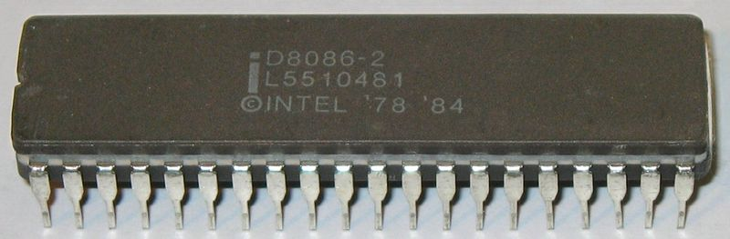
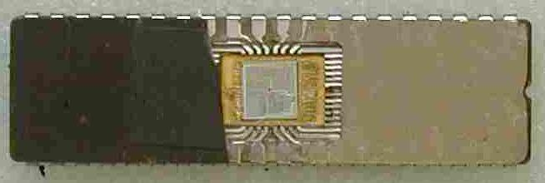
8086 CPU
Intel 8086 microprocessor is a first member of x86 family of processors. The 8086 has complete 16-bit architecture. That is 16-bit internal registers, 16-bit data bus and a 20-bit address bus (1 MB of physical memory). Because the processor has 16-bit index registers and memory pointers, it can effectively address only 64 KB of memory. To address memory beyond 64 KB the CPU uses segment registers - these registers specify memory locations for code, stack, data and extra data 64 KB segments. The segments can be positioned anywhere in memory, and, if necessary, user programs can change their position.
Intel 8086 instruction set includes a few very powerful string instructions.
The CPU recognizes all Floating-Point instructions.

Slide 3
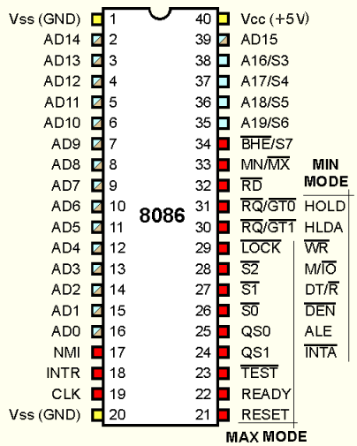
8086 Pinouts

Slide 4
8086 CPU Registers

Slide 5
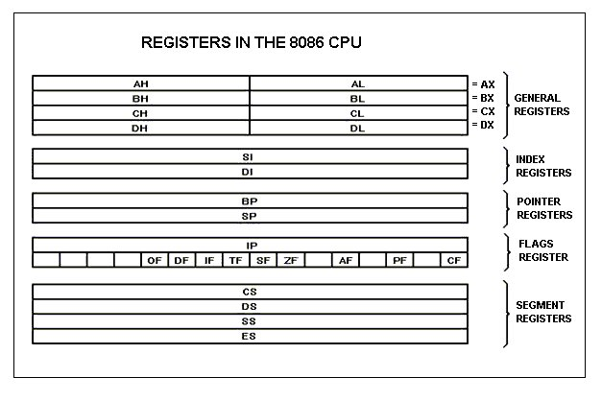
Which are the Registers

Slide 6
General Purpose Registers
8086 CPU has 8 general purpose registers.
The following four registers can work as 8-bit Registers.
AX - Accumulator register (divided into AH / AL):
  Arithmetic, logic and data transfer
  Input & Output
BX - Base address register (divided into BH / BL)
CX - Count register (divided into CH / CL):
  Iterative code segments using the LOOP instruction
  Repetitive operations on strings with the REP command
DX - Data register (divided into DH / DL):
  DX:AX concatenated into 32-bit register for some MUL and DIV operations
  Specifying ports in some IN and OUT operations
SI - Source Index register:
  Can be used to point at the address of data
  Used as source in some string processing instructions
  Offset address relative to DS
DI - Destination Index register:
  Can be used to point at the address of data
  Used as destination in some string processing instructions
  Offset address relative to ES
BP - Base Pointer:
  Primarily used to access parameters passed via the stack
  Offset address relative to SS
SP - Stack Pointer:
  Always points to top item on the stack
  Offset address relative to SS

Slide 7
Segment Registers
Code Segment Register (CS) - points at the segment containing the current program.
Data Segment Register (DS) - generally points at segment where variables are defined.
Extra Segment Register (ES) - extra segment register, it's up to a coder to define its usage.
Stack Segment Register (SS) - points at the segment containing the stack.

Slide 8
How do the Segment Registers Work
Although it is possible to store any data in the segment registers, this is never a good idea. The segment registers have a very special purpose which is pointing at accessible blocks of memory. Segment Registers work together with General Purpose Register to access any memory value.
For example if we would like to access memory at the physical address 12345h, we could set the DS = 1230h and SI = 0045h. This way we can access much more memory than with a single register, which is limited to 16 bit values.
The CPU gets the physical address by multiplying the segment register by 10h (16 decimal) and adding the General Purpose Register to it. That is (1230h x 10h) + 45h = 12345h ((DS x 10h) + SI).
The address formed by the 2 registers is called an effective address.
  By default BX, SI and DI registers work with DS register
  BP and SP work with SS segment register
  Other general purpose registers cannot form an effective address.
  Also, although BX can form an effective address, BH and BL cannot.

Slide 9
Special Purpose Registers
IP - Instruction pointer:
  Always points to next instruction to be executed
  Offset address relative to CS
Flags Register
  Determines the current state of the processor. They are modified automatically by CPU after mathematical operations, this allows to determine the type of the result, and to determine conditions to transfer control to other parts of the program.
  Generally one cannot access these registers directly.

Slide 10
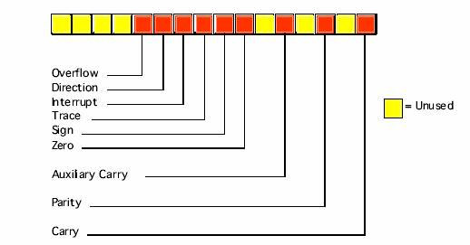
Flags Register

Slide 11
Flags Register
Carry Flag (CF) - this flag is set to 1 when there is an unsigned overflow. When there is no overflow this flag is set to 0.
Parity Flag (PF) - this flag is set to 1 when there is even number of one bits in result, and 0 when there is odd number of one bits.
Auxiliary Flag (AF) - set to 1 when there is an unsigned overflow for low nibble (4 bits).
Zero Flag (ZF) - set to 1 when result is zero. For non-zero result this flag is set to 0.
Sign Flag (SF) - set to 1 when result is negative. When result is positive it is set to 0. (This flag takes the value of the most significant bit.)
Trap Flag (TF) - Used for on-chip debugging.
Interrupt enable Flag (IF) - when this flag is set to 1 CPU reacts to interrupts from external devices.
Direction Flag (DF) - this flag is used by some instructions to process data chains, when this flag is set to 0 - the processing is done forward, when this flag is set to 1 the processing is done backward.
Overflow Flag (OF) - set to 1 when there is a signed overflow.

Slide 12
Memory Segmentation
The memory in 8086 is organized as segmented memory. In this scheme the physical memory may be divided into a logical segments. Each segment is 64K bytes in size and is addressed by one of the segment registers. To address a specific memory location within the segment, we need an offset. The offset is also 16-bit long so that the maximum offset value can be FFFFH and maximum size of any segment is 64K locations.
Notes:
To emphasize this concept, we will consider an example of a housing colony containing 100 houses. The simple method of numbering the houses will assign the numbers from 1 to 100 to each house sequentially. Suppose now, one wants to find out the house number 67, then he/She will start from 1 and go on till he/she finds the house numbered 67. Consider another case where the houses are arranged in the 10 X 10 ( rows and columns) pattern. In this case to find out the house number 67, one may directly go to the 6th Row and then 7th column. In the second scheme, the efforts required for finding the same house will be too less. This second method is similar to segmented memory scheme, where addresses are specified in terms of segment addresses similar to rows and offset addresses similar to columns.

Slide 14
Advantages of Memory Segmentation
Allows the memory capability to be 1Mbytes although the actual addresses to be handled are 16-bit size.
Allows the placing of Code, Data and Stack portions of the same program in different parts (segments) of memory for data and code protection.
Provision of relocation.( permit a program or its data to be put into different areas of memory each time the program is executed.

Slide 15
References
http://www.cpu-world.com/CPUs/8086/
http://www.cs.ucd.ie/staff/jcarthy/home/alp/8086Registers.pdf
http://www.xs4all.nl/~ganswijk/chipdir/n/808.htm
http://www.electronics.dit.ie/staff/tscarff/8086_registers/8086_registers.html
http://www.faculty.iu-bremen.de/birk/lectures/PC101-2003/01x86/80x86%20Architecture/registers.htm
http://mirror.href.com/thestarman/asm/debug/8086REGs.htm#REGS
http://library.n0i.net/hardware/i8086opcodes/#1

